Slide 1


Financial Analysis of Telsa, Inc.
Prof. Pratik Bedi
Group 3 – DAB 401-001

Slide 2



OUR TEAM MEMBERS – GROUP #3
Tehsin Shaikh
Srilakshmi Gummadidala

Slide 3
TABLE OF CONTENTS
1. Project Scope
2. Business Analysis
3. Ratio and valuation Analysis
4. Technical Analysis
5. Conclusion
6. Recommendations

Slide 4
PROJECT SCOPE
The objective of this project is to conduct a thorough financial analysis of Tesla, Inc., integrating theoretical concepts with practical insights gained from the course.
The analysis encompasses business operations, financial ratios, CAPM, and stock price forecasting using Monte Carlo simulation, FB Prophet, and other technical analysis tools.
By applying these methodologies, we aim to provide valuable insights into Tesla's financial performance, market positioning, and future stock price trends.

Slide 5
Business Analysis
Tesla, Inc. is a pioneering company in the electric vehicle (EV) and clean energy industry.
Known for its innovation, it has a significant impact on automotive and energy sectors.
The Automotive segment deals with Electric vehicles, sales of regulatory credits, direct and used vehicle sales, Supercharger network, in-app upgrades, and vehicle service options.
Energy Generation and Storage segment: Focuses on solar energy and energy storage products.
Offers installation and repair services.
Originally named Tesla Motors, Inc., rebranded in 2017.
Headquartered in Austin, Texas.

Slide 6
History of the Tesla, Inc
Founding:
Founded in 2003 by a group of engineers including Martin Eberhard and Marc Tarpenning.
Elon Musk, a major contributor of initial funding, joined as chairman of the board.
Early Developments:
Tesla's first vehicle, the Roadster, debuted in 2008, showcasing the potential for high-performance electric vehicles.
Expansion:
The company expanded its lineup with the Model S, Model X, Model 3, and Model Y, gaining widespread attention and market share.
Innovation:
Tesla has been at the forefront of automotive technology, developing advanced battery technology, software, and self-driving capabilities.

Slide 7
Current Operations
Products: Tesla's current product lineup includes electric vehicles like the Model S, Model 3, Model X, Model Y, and the upcoming Cybertruck and Roadster. They also manufacture solar products and energy storage solutions like the Powerwall, Powerpack, and Solar Roof.
Services: Tesla provides charging solutions through its Supercharger network, software updates, and autonomous driving features.

Slide 8
Macroeconomic Environment
Growth Strategy: Tesla's growth has been largely organic, focusing on scaling up production, entering new markets, and developing new products. They have also acquired several companies to enhance their technology and production capabilities.
Market Influence: As a market leader in EVs, Tesla's strategies and performance significantly influence the overall market dynamics in the EV industry.

Slide 9
Competitive Landscape and Market Dynamics
Industrial Competitors
Traditional automakers entering EV market: General Motors, Volkswagen, Ford, Nissan, Nio, Honda.
Other EV-specific competitors: Rivian, Lucid Motors.
Energy sector competitors: SunPower and LG Chem in solar and battery storage.
Market Share
Tesla dominates electric vehicle market in regions like the US and Europe.
Competitors' market share varies based on regions and specific segments (luxury vs. mass-market EVs).
Market shares fluctuate due to factors like production capacity and market demand.
Tesla sets standards in technology, marketing, and production, extending influence beyond market share.
Key player in shaping future of sustainable transportation and energy through innovation and expansion strategies.

Slide 10
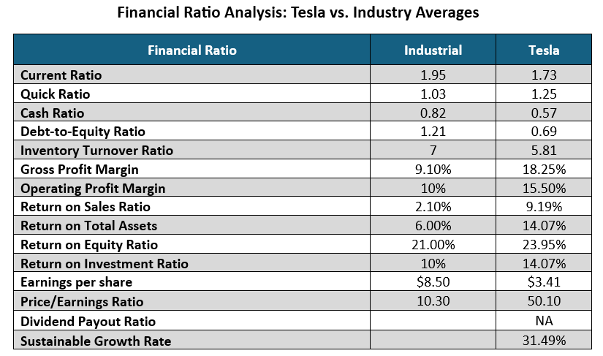
Tesla Financial Ratio Analysis
This analysis offers a detailed comparison of tesla's financial performance to industry averages across key ratios.
It covers liquidity, leverage, efficiency, profitability, and market ratios, highlighting tesla's strengths and areas for improvement within the automotive industry.
Tesla outperforms industry averages in key financial ratios.
Lower liquidity, but efficient short-term liability coverage.
Lower debt reliance and higher profitability.
Superior returns on sales, assets, and equity.
Higher price/earnings ratio indicates investor confidence and growth expectations.
Tesla retains all earnings as it does not pay dividends (Retention ratio: 1). Due to the lack of dividend per share values, the dividend payout ratio cannot be calculated.

Slide 11
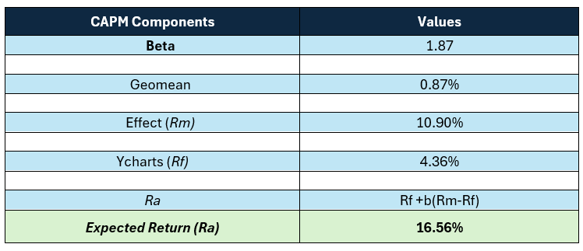
Capital Asset Pricing Model (CAPM)
CAPM is a financial model that determines expected investment returns by considering an asset's systematic risk relative to the market and the risk-free rate of return.
Beta > 1: Indicates higher volatility than the market, with a 1% market change resulting in approximately 1.87% asset price change.
Higher beta suggests higher risk but potentially higher returns.
Expected return: ~16.56% (CAPM), exceeding targeted return of 14.07%.
Investors should assess risk, align with objectives, and consider diversification strategies.

Slide 12
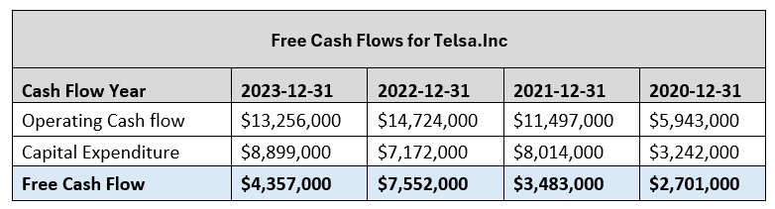
Analysis of Free Cash Flows (FCF)
Tesla's operating cash flow has steadily increased from $5.94 billion in 2020 to $13.26 billion in 2023.
This reflects improved cash generation from core operations.
Capital expenditure has also risen, indicating significant investments in infrastructure.
Despite fluctuations, free cash flow remained positive, showing effective cash flow management.
Further analysis is needed to understand the slight decrease in free cash flow in 2023 and ensure sustainability.

Slide 13
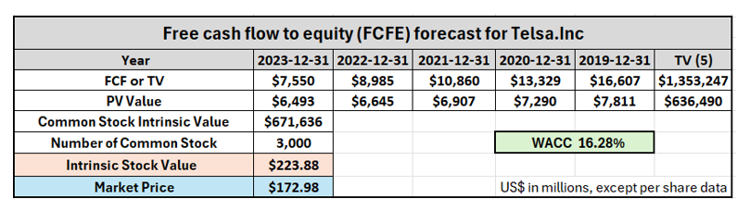
Analysis of stock price w.r.t. market price
Intrinsic stock value: $233.88.
Market price: $172.98.
Factors contributing to the difference:
Intrinsic calculations based on estimated future cash flows and discount rates, which may differ from market perceptions.
Market price influenced by investor sentiment, macroeconomic factors, and liquidity.
Market may have additional information or perspective not fully captured in intrinsic value model, leading to divergence in valuation.

Slide 14
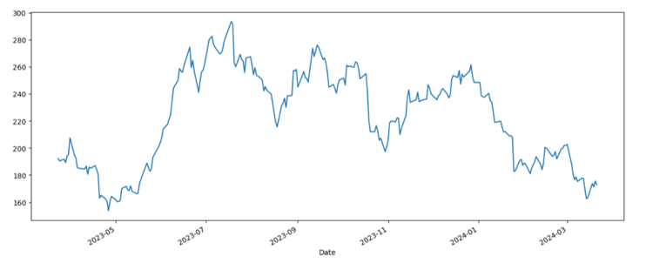
One-year trend of TSLA's stock prices
One-year stock price trend graph for TSLA shows significant fluctuation.
Initially, a steady increase indicates bullish market sentiment.
Subsequent volatility characterized by peaks and troughs suggests market indecision or reaction to external factors.
Decline in later part indicates bearish phase driven by selling pressure.
Understanding stock price in relation to historical highs and lows can provide buy or sell signals.
Overall trajectory reflects significant fluctuations influenced by market forces and company-specific news.

Slide 15
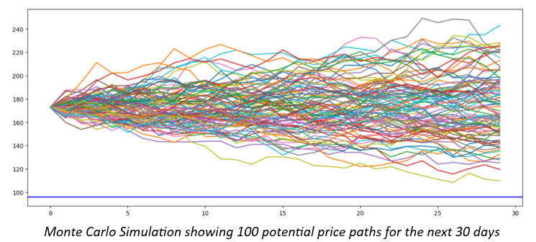
Monte Carlo Simulation Analysis
Monte Carlo simulation projects future Tesla stock prices based on historical data.
Graph displays range of possible outcomes, emphasizing uncertainty and risk.
Simulation forecasts Tesla stock price for next 30 days with 100 iterations.
Wide distribution of future prices underscores stock's volatility.
Increasing uncertainty over time indicated by spreading paths, signaling higher expected volatility and investment risk.

Slide 16
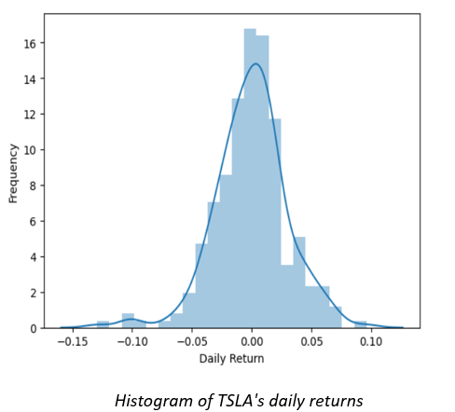
Daily Returns Analysis - Histogram
Analysis of TSLA's stock daily returns reveals insights into day-to-day fluctuations.
Histogram of daily returns provides a tool for understanding the distribution of stock price changes.
Bell-shaped curve suggests a normal distribution of returns, centered around the mean.
Implies that most returns will be near the average, with extreme returns being less common.
Assumption in finance aids in understanding stock price variability and risk

Slide 17
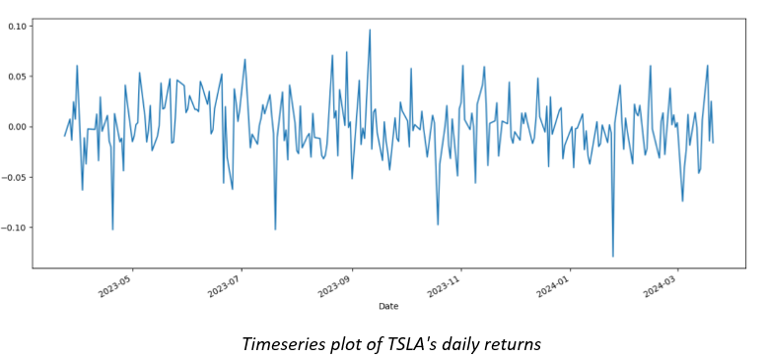
Timeseries plot of TSLA's daily returns
Time series plot of daily returns illustrates volatility over time with no discernible trend.
Indicates returns follow a "random walk" pattern, suggesting randomness in price movements.
Past price movements are not reliable indicators of future price directions.
Emphasizes unpredictable nature of stock market and challenges in forecasting future prices.
Highlights importance of diversification and risk management strategies in investment.

Slide 18
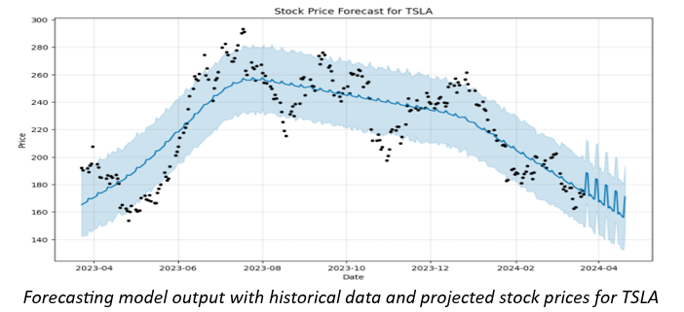
FB Prophet Forecast Analysis
FB Prophet model employed to analyze TSLA's stock price data.
Model provides forecasts and decomposed components including trends, weekly and yearly seasonality, and holiday effects if applicable.
Crucial for understanding underlying factors driving stock price movements.
Forecast graph displays historical adjusted close prices and model's future price predictions.
Shaded area represents uncertainty intervals, indicating possible range of future stock prices.

Slide 19
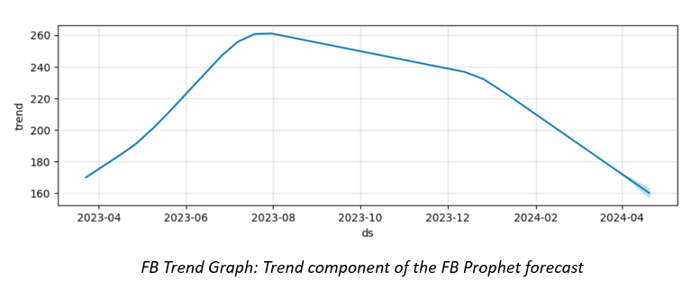
Trend component of the FB Prophet forecast
FB Prophet model's trend component shows general direction of TSLA's stock price over time.
Indicates strong uptrend until 2023-08, followed by predicted downtrend.

Slide 20
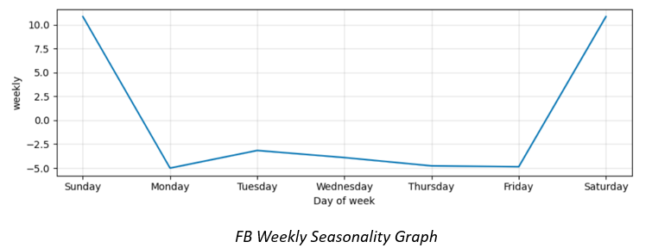
FB weekly seasonality component
FB Prophet's weekly seasonality component reveals weekly patterns in TSLA's stock behavior.
Indicates variability in performance based on the day of the week.
Helps understand factors driving forecasts, like long-term trends and repetitive weekly patterns.
FB Prophet's predictions are informed estimates, not certainties, and come with inherent uncertainty.

Slide 21
Conclusion
Tesla's financial analysis demonstrates its dominant presence in the electric vehicle and clean energy industry, with strong operational efficiency and profitability, albeit with some liquidity considerations.
Despite fluctuations, Tesla's favorable valuation metrics and promising growth prospects position it as an appealing investment opportunity, provided investors implement careful risk management strategies to navigate the inherent stock price volatility.

Slide 22
Recommendations
Tesla presents a compelling investment opportunity due to its robust financial performance, characterized by strong liquidity, profitability, and efficiency ratios.
The undervaluation implied by the stock's intrinsic value compared to its market price suggests a potential BUYING opportunity for investors.
With its track record of innovation and market leadership, Tesla is well-positioned to capitalize on emerging opportunities in the electric vehicle and clean energy sectors.
The Capital Asset Pricing Model (CAPM) indicates an attractive expected return relative to its risk profile, further reinforcing Tesla's investment appeal.

Slide 23
REFERENCES
1. Doll, S. (2021, July 14). Tesla factory locations: Where they are and could soon be. Electrek.
(Tesla factory locations: Where they are and could soon be | Electrek).
2. Fruhlinger, J. (2019, January 9). Tesla’s growing worldwide presence. The Business of Business.
(Tesla's growing worldwide presence | The Business of Business).
3. Thompson, A. (2023, September 5). Tesla’s Operations Management: 10 Decision Areas, Productivity. Panmore Institute.
(Tesla’s Operations Management: 10 Decision Areas, Productivity - Panmore Institute)
4. Tesla’s Lineup: Exploring Models S, 3, X, Y & 2023 Roadster. (2023, July 4). Steer EV
(https://steerev.com/electric-vehicles-evs/teslas-lineup-exploring-models/)
5. Investopedia Team. (2022, August 30). Who Are Tesla’s (TSLA) Main Competitors? Investopedia
(Who Are Tesla's (TSLA) Main Competitors? (investopedia.com)
6. Tesla Inc. (NASDAQ: TSLA) Present Value of Free Cash Flow to Equity (FCFE). (n.d.). Stock Analysis on Net.
(https://www.stock-analysis-on.net/NASDAQ/Company/Tesla-Inc/DCF/Present-Value-of-FCFE)

Slide 24
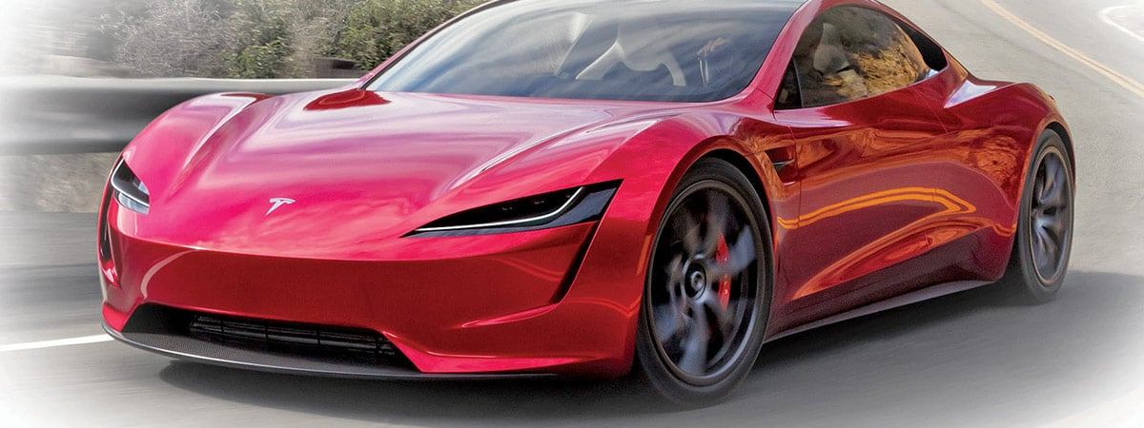
Thanks for joining our Tesla financial journey!

